Slide 1
Tellurometer (EDM)
Microwave measurement of distance

Slide 2
How they work
The slave and master are totally independent units – not synchronized in any way.
Independent 10GHz carrier (Klystron) frequency modulated independently by slave and master. Think of this a bit like sending pulses of light.
Slave and Master mix their transmitted and received signals and form an amplitude modulated IF from which they can recover the phase difference between the modulations. Red / Black arrows on diagram.
On its own this gives no info as the modulations are unsynchronized (and insufficiently stable given technology of the time)

Slide 3
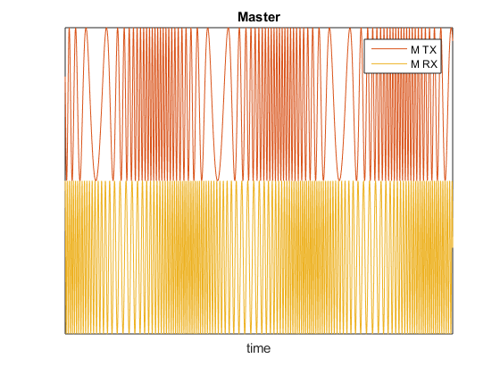
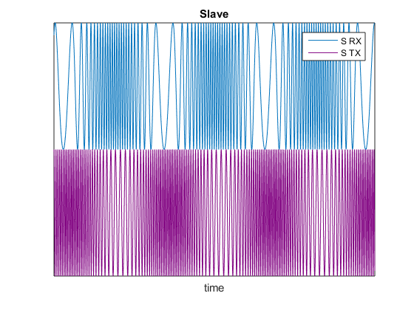
Microwave Measurement of Distance

Slide 4
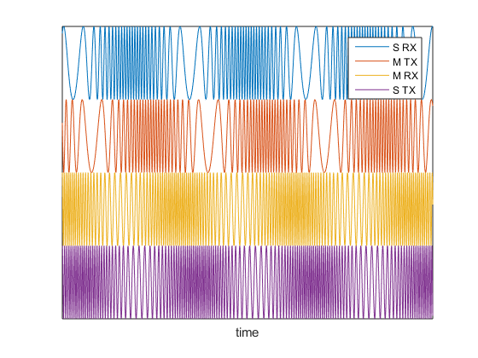
Making measurement at master
Suppose the slave could send its black arrow phase measurement back to the master though?
If we put all the graphs together, we see slave RX delayed from slave TX (top two) same amount as master RX delayed from master TX (bottom two)

Slide 5
Subtract the arrows
Arrow minus gives phase angle shift over distance in terms of the Master modulation
We can recover a distance (up to multiples of the modulation wavelength)
Change the modulation frequency A,B,C,D,E to read out separate digits of the distance (100km, 10km, … 10m) and we have a distance measurement between stations
What might go wrong? Reflections from ground, temperature affecting refractive index.

